Slide 1

CAPSTONE PROJECT
ADVANCED LIBRARY MANAGEMENT SYSTEM USING STRUCTURES AND POINTERS
Team no.7
CSA0219 –C Programming For Logical Thinking
Guided By
Dr. S. K. Saravanan & Dr. A. M. Arul Raj
Professor
Institute of CSE
SIMATS Engineering
Student Name
Rashmitha S (192525034)
Vaishali S (192525024)
Institute of AIML
SIMATS Engineering
Notes:
1
1

Slide 2


Introduction
A library is an important place to store and manage books.
Manual library management is time-consuming and error-prone.
This project automates basic library operations using C programming.
It uses structures and pointers to manage book records efficiently.
The system supports adding, searching, issuing, and returning books.
Fine calculation and usage tracking are also implemented.
The project helps improve accuracy and efficiency in library management.

Slide 3
Abstract
• This project focuses on developing a Library Management System using C programming.
• It helps in maintaining book records in an organized manner.
• Structures are used to store book details such as ID, name, author, and quantity.
• Pointers are used for dynamic memory allocation and efficient data handling.
• The system supports adding, searching, issuing, and returning books.
• Fine calculation is implemented for late book returns.s
• The project improves accuracy, efficiency, and ease of library management.

Slide 4

Aim and Objective
To store book information using structures.
To use pointers for dynamic memory management.
To add new books without duplication.
To allow searching books using book ID.
To manage book issuing and returning operations.
To calculate fine for late book returns.
To track the most issued books for analysis.

Slide 5
Literature Review & Requirement Analysis
S.No | Year of Publication | Author | Title of the Journal / Book | Methodology Used | Algorithm Used | Key Findings (Drawbacks Identified)
1 | 2019 | E. Balagurusamy | Programming in ANSI C | Structured programming using C language | Array-based and structure-based data handling | Does not provide a complete application-level library management system
2 | 2016 | Yashavant P. Kanetkar | Let Us C | Modular programming with functions | Conditional logic and loop-based algorithms | Covers basic concepts but lacks advanced features like analytics
3 | 2014 | Herbert Schildt | C: The Complete Reference | System-level programming concepts | Pointer-based memory management algorithms | Explains concepts well but not domain-specific applications

Slide 6


Problem Statement
Traditional libraries use manual record keeping.
Manual records are difficult to maintain and update.
Searching for books takes more time.
Book availability is hard to track manually.
Fine calculation is not automated in manual systems.
Popular book analysis is not possible easily.
A computerized solution is required to solve these issues.

Slide 7

Existing System
The existing system is mostly manual.
Book details are written in registers.
Searching records takes a long time.
Errors occur due to human mistakes.
Book issue history is not maintained properly.
Fine calculation is done manually.
The system lacks data security and accuracy.

Slide 8

Proposed System
The proposed system is a C-based application.
It uses structures to organize book data.
Pointers are used for dynamic storage.
Book issuing and returning are automated.
Fine is calculated automatically based on rules.
The system tracks book usage frequency.
It provides a simple and efficient solution.

Slide 9
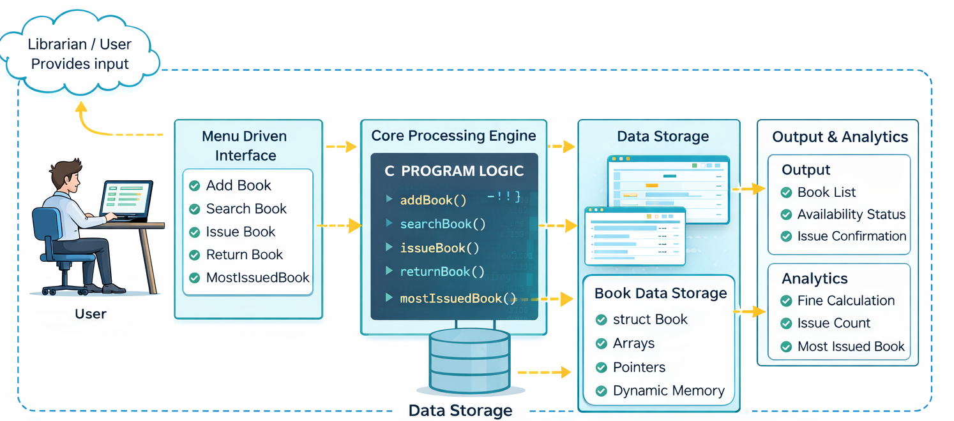
Overall System Architectural Design

Slide 10
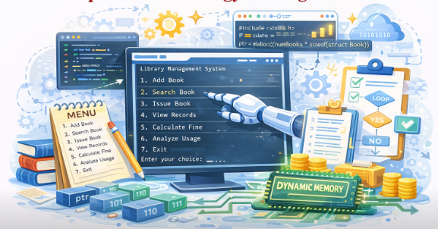
Proposed Methodology and Algorithm
• The system is designed as a menu-driven C application.
• User choices control the execution flow of the program.
• Each operation is executed through a separate function.
• Decision making is handled using conditional statements.
• Repetitive operations are managed using looping structures.
• Memory is allocated dynamically to handle varying data size.
• The algorithm ensures correct and efficient library operations.

Slide 11

Design & Module Planning
• The system design follows structured approach.
• The project is divided into logical modules for clarity.
• Each module performs a specific library function.
• Modular design makes easy to understand and modify.
• Data flow between modules is clearly defined.
• Errors can be identified and fixed at module level.
• This improves maintainability and scalability of the system.

Slide 12
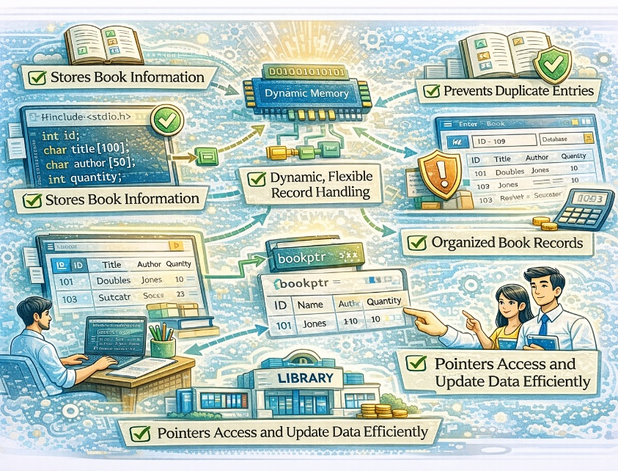
Module 1 – Data Management Module Introduction
• This module is responsible for handling all book-related data.
• It defines the structure used to store book information.
• Book details such as ID, name, author, and quantity
are managed here.
• Data is stored dynamically to allow flexible record
handling.
• Duplicate book entries are prevented in this module.
• The module supports adding and displaying book records.
• Pointers are used to access and update data efficiently.
• This module forms the foundation of the entire library system.

Slide 13
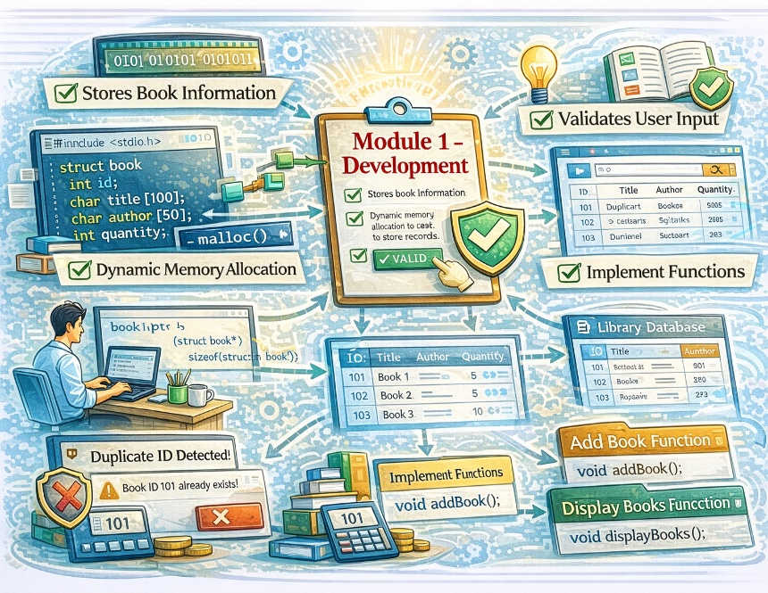
Module 1 - Development
• A structure is created to store book information.
• Dynamic memory allocation is used to store records.
• User inputs are validated before storing data.
• Duplicate book IDs are checked and
restricted.
• Functions are implemented to add new book
records.
• Functions are used to display stored book details.
• Pointer access ensures efficient data manipulation.

Slide 14
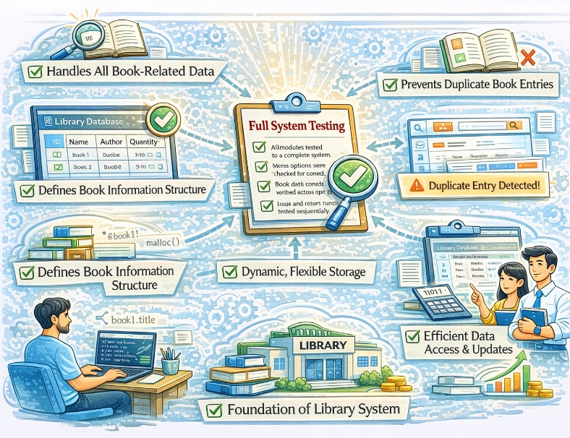
Module 1 - Testing & Review
• Book data insertion was tested with different input values.
• Duplicate book ID validation was verified successfully.
• Dynamic memory allocation was checked for
proper usage.
• Data retrieval accuracy was tested during display
operations.
• Invalid inputs were handled without program failure.
• Memory access through pointers was reviewed for correctness.
• The module produced consistent and reliable results.

Slide 15
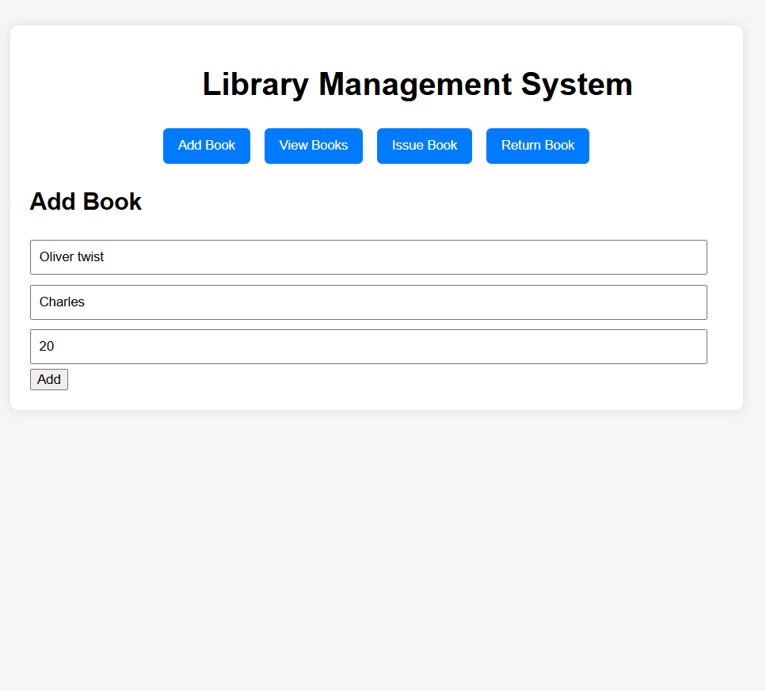
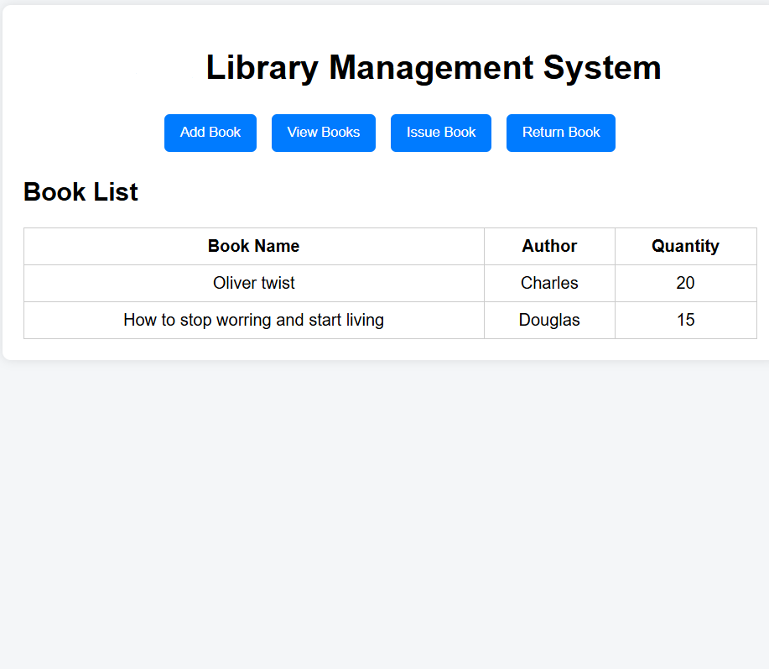

Slide 16
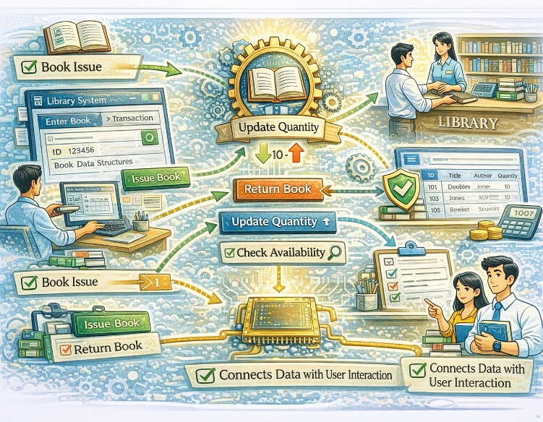
Module 2 – Library Operation & Control Module (Introduction)
• This module manages all library transactions and operations.
• It controls book issuing and returning activities.
• The module ensures correct update of book quantities.
• It handles user requests through function calls.
• Operational rules are applied during each transaction.
• Book availability is verified before processing actions.
• This module connects data management with user interaction.

Slide 17
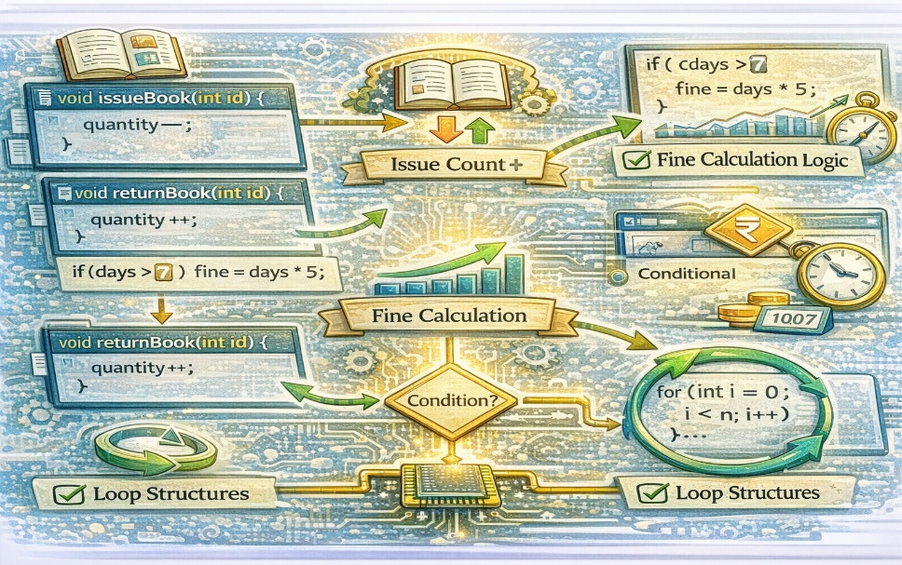
Module 2 - Development
• Functions are implemented for issuing books.
• Book quantity is reduced when a book is issued.
• Issue count is increased for usage tracking.
• Return functionality updates book quantity
correctly.
• Fine calculation logic is implemented for late
returns.
• Conditional statements control transaction validity.
• Loop structures ensure smooth operation flow.

Slide 18
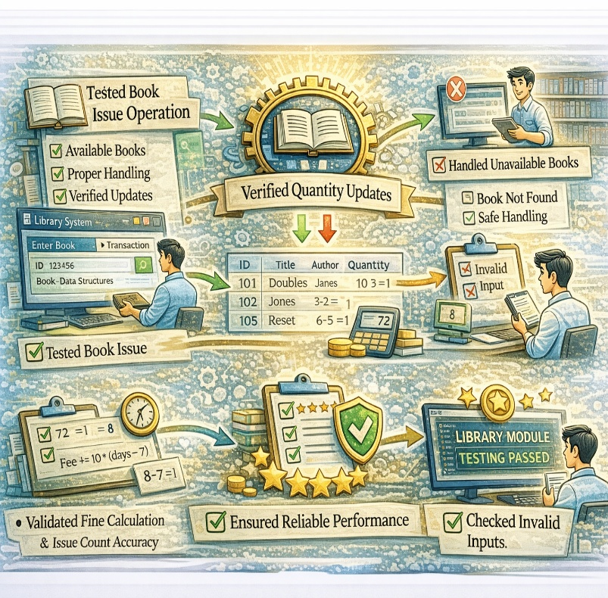
Module 2 - Testing & Review
• Book issue operation was tested with available books.
• Unavailable book issue cases were handled properly.
• Quantity updates were verified after each transaction.
• Fine calculation was tested for different return days.
• Issue count accuracy was validated for analytics.
• Invalid inputs were tested for safe execution.
• The module performed all operations reliably.

Slide 19
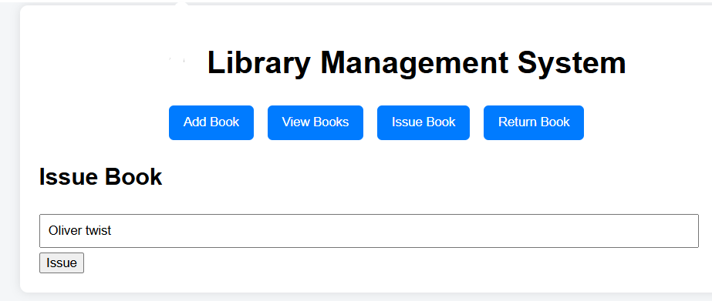
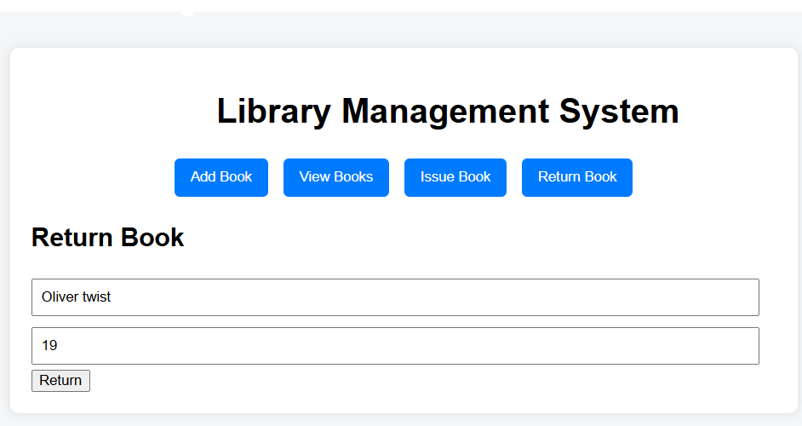

Slide 20

System Debugging & Optimization
Logical errors were identified during program execution.
• Input validation issues were corrected systematically.
• Pointer usage was reviewed to avoid memory access errors.
• Conditional logic was optimized for better control flow.
• Redundant code segments were removed for clarity.
• Program execution speed was improved through optimization.
• Overall system stability was enhanced after debugging.

Slide 21
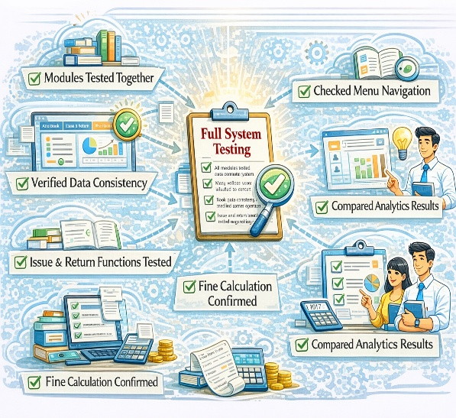
Full System Testing
All modules were tested together as a complete system.
• Menu options were checked for correct navigation.
• Book data consistency was verified across operations.
• Issue and return functions were tested sequentially.
• Fine calculation accuracy was confirmed for multiple cases.
• Analytics results were compared with expected values.
• The system passed all functional test scenarios.

Slide 22

Solution Design and Implementation
The solution was designed using a modular approach. • System requirements were analyzed before implementation. • C programming concepts were applied during development. • Structures were used to organize library data. • Pointers enabled dynamic memory management. • Functions were implemented for each library operation. • The solution was implemented successfully as planned.

Slide 23
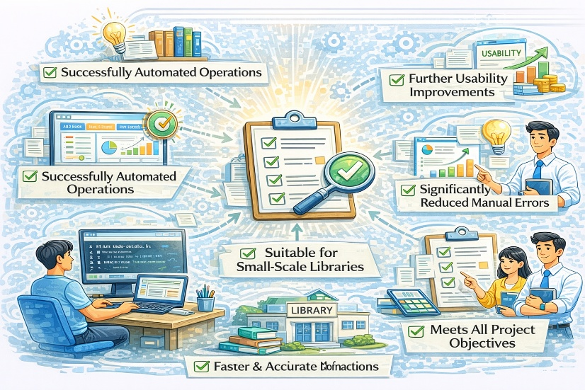
Results and Recommendations
• The system successfully automated library operations. • Book management became faster and more accurate. • Manual errors were significantly reduced. • The system met all project objectives. • It is suitable for small-scale library environments. • Further improvements can enhance usability. • The project is recommended for academic applications.

Slide 24
Reflection on Learning and Personal Development Conclusion
This project helped to understand the basics of C programming clearly.
• Helping to learn how to use structures to store and manage book records efficiently.
• Pointers helped to understand dynamic memory allocation in C.
• The project improved logical thinking and problem-solving skills.
• Debugging the program enhanced understanding of program flow.
• Learning in designing the project using modular and structured coding practices.
• Overall, this project strengthens technical skills and confidence in C programming.

Slide 25
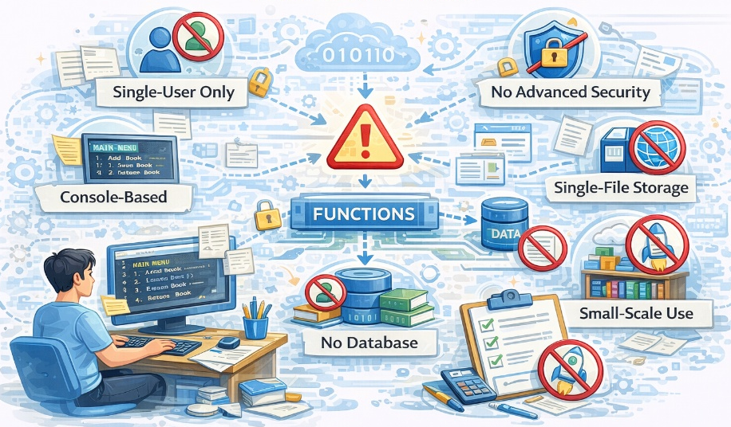
Limitations
The system supports only single-user access.
Data is not stored permanently.
The system is console-based in C.
No database is used for storage.
Network access is not supported.
Advanced security features are not included.
The project is suitable for small-scale use.

Slide 26

Future Enhancement
File storage can be added for data saving.
Database support can be integrated.
Multi-user access can be implemented.
A full graphical interface can be developed.
User login features can be added.
Reports can be generated automatically.
The system can be expanded for large libraries.

Slide 27
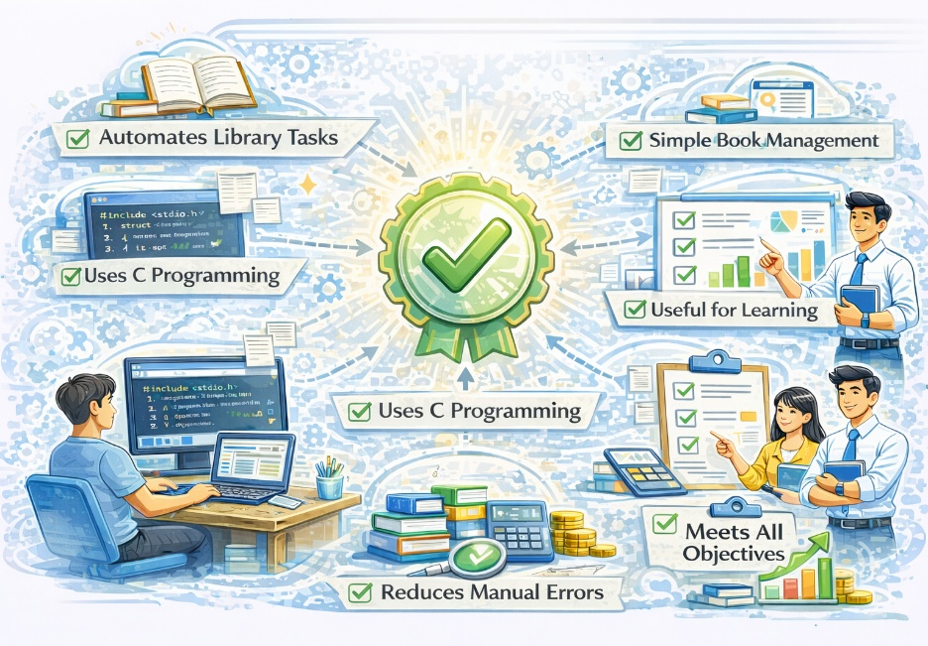
Conclusion
The project successfully automates library tasks.
It uses C programming concepts effectively.
Structures and pointers improve data handling.
The system reduces manual errors.
Book management becomes simple and fast.
The project meets all stated objectives.
It is useful for academic and learning purposes.

Slide 28
References
[1] E. Balagurusamy, “Programming in ANSI C,”McGraw-Hill Education, 8th Edition, 2019.
[2] B. W. Kernighan and D. M. Ritchie,“The C Programming Language,”Prentice Hall, 2nd Edition, 1988.
[3] Y. P. Kanetkar, “Let Us C,”BPB Publications, 15th Edition, 2016.
[4] H. Schildt, “C: The Complete Reference,”McGraw-Hill Education, 4th Edition, 2014.
[5] GeeksforGeeks,“C Programming – Structures and Pointers,” Online Technical Resource, 2023.

